Slide 1
Internet Revolution in China: Innovation on E-commerce Logistics Business Models
Zhilun（Allen） Jiao
Logistics Research Center
Nankai University
Oct. 2018

Slide 2
Contents
Internet Revolution in China
Business Model Innovation
Summary and Insights

Slide 3
Internet revolution in China
In China, Internet usage started relatively late, however it has been developing rapidly.
In 2016, the smartphone penetration rate reached 95.6%, thanks to the widespread use of smartphone applications and the increase of the internet penetration rate.
Along with the internet penetrating into different industries, transactions on e-commerce are increasing substantially. In 2017, China’s online retail sales reached 7.18 trillion yuan and a year-on-year increase of 32.2%. The online retail sales of physical commodities accounted for 15% of the total retail sales of consumer goods.
The future of the Internet revolution in China will rely on the Integrated Internet of Things.
Smart Phone Penetration rate(%)
Internet penetration rate(%)
Development of mobile phone and Internet penetration rate in China
Desktop Internet
Single terminal
Person to person
Mobile Internet
Multi-terminal
Local Internet of Things
Ubiquitous terminals
Real-time, online, multiple types
Wireless, high-speed, multiple types
Interconnection is partially automatic
Intelligent processing: small range
Integrated Internet of Things
Ubiquitous terminals
Low speed, wired connection
Network reliability
Intelligent information processing
Online Retail Volume and Growth Rate in China for 2012-2016
Notes:
In 99 I use the email for the first time when I was into the college, at that time most of Chinese do not have any idea about the internet of computer
But right now, I use intelligent voice box, speakers to help me open the TV. To do this, they had to connect to each other as a internet of things

Slide 4
Business Model
Express franchises network
Specific business model
Similar as chain stores
Headquarters are responsible for the main transport lines and the construction of distribution centers. Their main task is to receive and deliver express parcels
Coverage area: 3 square kilometers (in large cities with high population density)
Market drivers
Many e-commerce companies are using logistics outsourcing
Express network expanding requires rapid replication of terminals
Factors of production are involved rapidly into the industry
Status and trends
some companies in this industry are publicly listed companies
There have been trends of more strict standard in company management and more direct sales in company operation.
Express delivery business volume and growth rate (2009-2017)
Source: Compiled from China National Post Bureau, Statistics Bureau (2009-2017 data)
Notes:
The network organization mode of express franchises has been an important foundation for the rapid development of the express delivery industry in China. The scale of the express logistics is growing at a fast pace. The trunk line improved the economy of scale and the terminals are achieving a wide range of coverage.

Slide 5
Business Model
Platformization of the trunk line transportation
Specific business models
Use of the information system and apps to build an e-commerce platform for logistics services
Establish a real-time matching information platform for cargo owner and vehicles drivers
Build a fleet management platform for reorganization of individual vehicles
‘Logistics park + information system’are used to organize transport and intermediaries
Market drivers
The industry concentration of China’s road freight is relatively low. Most vehicle for road freight are owned and operated by individuals. In 2016, 85.5% of the freight companies had less than 10 vehicles and 0.02% of the companies had more than 500 freight vehicles
How to organize those individual vehicles to provide effective transport services?
Status and trends
from a large-scale competition to a differentiate competition
China’s road freight enterprises and number of trucks
Year | 2012 | 2013 | 2014 | 2015 | 2016
Road operation trucks (10,000 units) | 1253.2 | 1419.5 | 1453.4 | 1389.2 | 1351.8
Number of households in the road transport business (10,000 households) | 752.0 | 745.2 | 757.6 | 718.2 | 679.1
Average number of trucks per household | 1.666 | 1.905 | 1.918 | 1.934 | 1.991
Source: Compiled from PRC Ministry of Transport and Chinese Federation of Logistics. China Road Freight Development Report (data from 2012-2017)
Notes:
This model appears in the upper stream of the industry value chain (bigger truck and long drive)

Slide 6
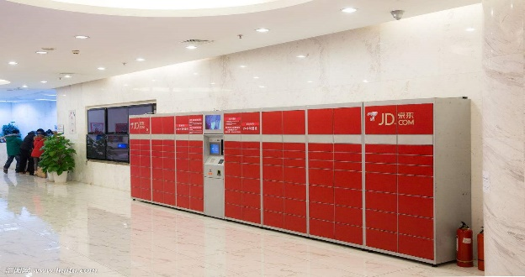
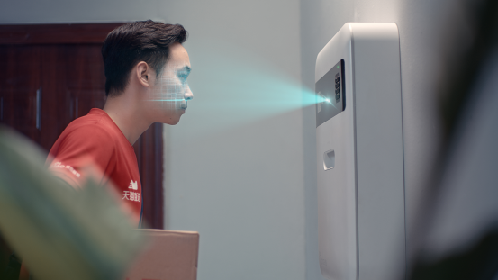
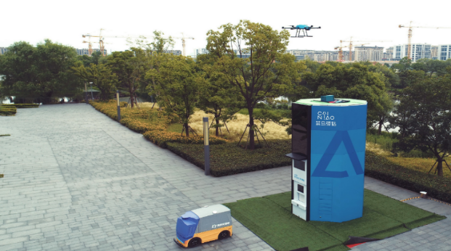
Business Model
“Last mile”delivery service
Specific business model
The parcels are delivered to a smart cabinet. The customer picks up the parcels by themselves
The parcels are delivered to a third-party collection stations located in convenience stores, pharmacies, laundries. Consumers can self-pickup or ask for a home delivery from the station.
Market drivers
Most online retail consumers are household consumers. E-commerce logistics need to find a way to enter into community families
Delivering service should create better customer experience and more customer value.
Status and trends
Companies are exploring new ways of parcel reception using modern equipment and Internet
Parcel receiving box
Unmanned vehicles
Smart buildings
Notes:
Third-party collection points require employees and “Self pick-up” cabinets are a form of unmanned operation.
Receiving boxes are installed at the door of each household in the building. This kind of box allow couriers to deliver the parcels when the customers are not at home. The courier arranges the delivery time in advance, by the time of the delivery opens the receiving box through face recognition. The capacity of this box can be adjusted any time according to the size of the parcel.
Cainiao is currently developing a system for receiving parcels at home. It consists in a pipe distribution system, which has several pipes connected to each living room in the building. Customers can receive their parcels without going out from their homes.
New technologies that allow customers to receive their parcels without being at home (Amazon key)

Slide 7
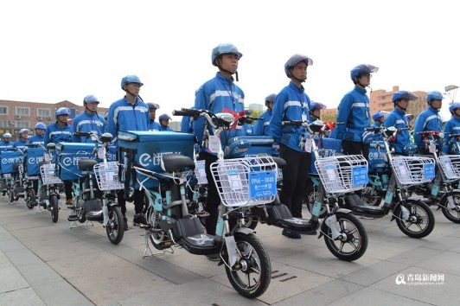
Business Model
Instant delivery logistics
Specific business model
No-storage distribution, immediate door-to-door delivery
Type of services: food delivery, takeaway, purchases and urgent deliveries
A huge two-wheeled fleet serves large-scale orders (electronic bikes)
Market drivers
Take-out delivery e-commerce expands rapidly in urban agglomerations.
Offline delivery and other multi-channel “new retails” need an instant logistics system
This mode of consumer logistics services has become very popular in large cities in China.
Status and trends
Good system scheduling capability and large-scale business cooperation network are the focus of their competitiveness
Some instant delivery logistics companies are becoming industry giants
2015Q1-2017Q4: Food and Beverage market in Internet - Market Trading Scale (China)
Source: Analysis International. Food and Beverage Internet Market, Annual Comprehensive Analysis 2018
Notes:
American takeaway delivery platform DoorDash has announced recently a $250 million financing, which will be made by Coatue Management and DST global.

Slide 8
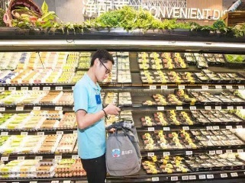
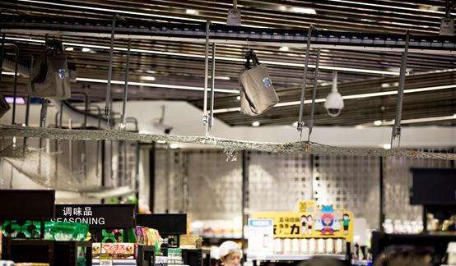
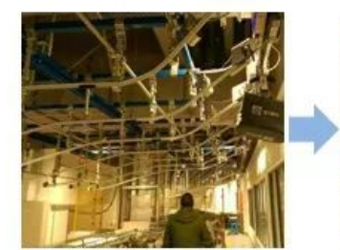
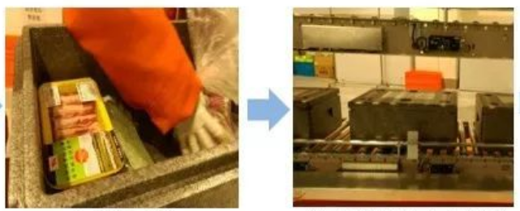
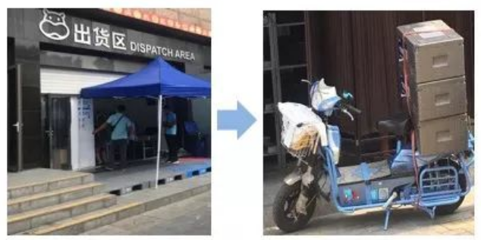
Business Model
Multi-channel collaborative logistics
Specific business model
Stores adopt two forms simultaneously: supermarkets for online retail and warehouses for offline retail
The service coverage for each store is around 3-5 square kilometers and the delivery is done in 30 minutes
The store is equipped with a fresh food supermarket and a food processing area
Market drivers
Service: ‘Online+ Offline’ integrated commerce. Use ‘both network and physical retail + instant delivery’ model instead of traditional e-commerce model‘network retail + express delivery’
Significant reduction on the cost of door-to-door distribution of fresh products
Status and trends
He Ma has become very popular and plans to open 100 stores during this year
Keep trying more innovations in operation and management
Up to July 31st, 2018, He Ma has opened 64 stores in the major cities of China. In their first one and a half year of operation, the average daily sales of 7 stores was around 800 thousand RMB. Sales per square meter were about 15,000 RMB (with an operating efficiency of 2-3 times more than other similar stores). Over 60% were online orders. He Ma provide free deliveries without purchase amount limit. And they promised to make door-to-door delivery within half an hour. Insulation boxes are used for cold chain delivery.
Source: (1) Alibaba's Vice President Hou Yi report at the Yunqi Conference on September 19th;
(2) Wu Tao. He Ma, trend research, 2018
Notes:
He Ma delivery logistics model

Slide 9
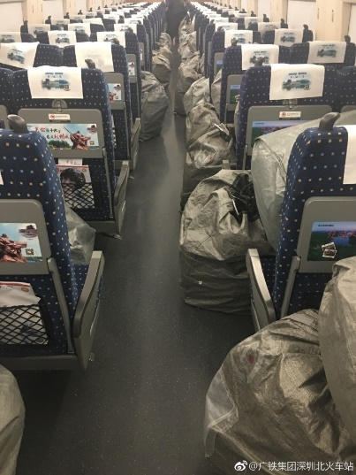
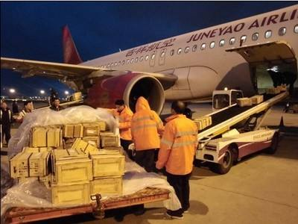
Business Model
Crowdsourcing
Specific business model
Employ non-professional staff to deliver parcels or takeaways
Shared warehouse (cloud storage) networks to achieve e-commerce area coverage
Terminals with “self-pickup” cabinets
Use of passenger transport capacity to carry parcels
Market drivers
Internet makes real-time transactions possible
Idle element resources (people, carrier, slot) can be rented out over time and generate revenue
Status and trends
Use both owned and shared resources at the same time
Capacity sharing is currently limited to peak periods (e.g. November 11th)
Shared facilities and equipment need to be improved.

Slide 10
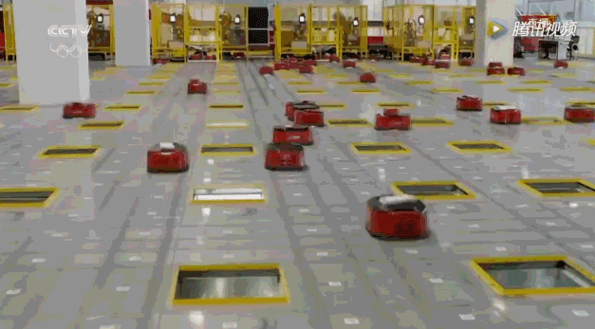
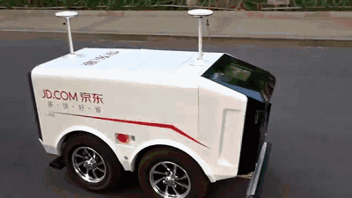
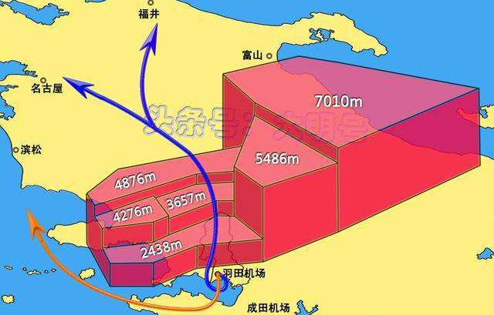
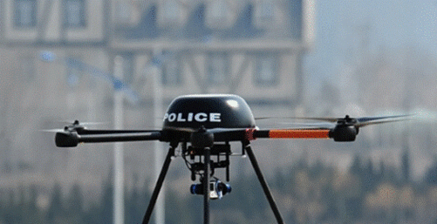
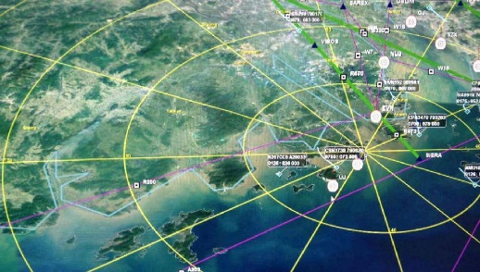
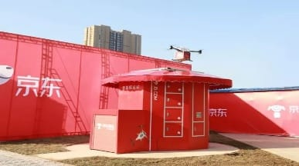
Business Model
Use new technologies to expand service capabilities
Specific business model
Use of unmanned equipment to enhance express logistics service capabilities
Unmanned storehouse, UAV and other unmanned vehicles
Market drivers
Development of Internet, Big Data and AI technology
Competition
The demand of rapid parcel delivery in complicated geographic and backward infrastructural conditions
Status and trends
Unmanned warehouse technology is quite mature. JD and Cainiao have already started using it.
UAV logistics is still under implementation. The government is formulating some policies and standards regarding this matter. Some companies such as SF Express and JD have started trial operations in remote areas with poor road conditions
Distribution on unmanned vehicles is still under testing. Regulations and policies for their urban operation are not available yet. Alibaba, JD, Suning as well as other enterprises have already invested in unmanned vehicles technology.
Airspace surveying and mapping
Use of UAV in aerial surveillance
Airspace application and electronic fence
Delivery facilities

Slide 11
Summary
Causes: Economic development and new technologies development
Response: Real-time transactions, payments and resource integration
The development of new technologies inspires the innovation of business models
Online retail increases consumers demand for small-volume logistics
Household customers requires fewer logistics time and better experience
Market competition requires cost control, financing capability enhancement and service quality improvement
Develop express delivery and instant delivery services
Use of crowdsourcing
Multi-channel resource integration
Improve timeliness, service quality and customer experience
Balance cost, profitability and financing capability
According to Cainiao, JD and other enterprises, the goal for Chinese express logistics services in the future will be ensure a 24-hour door-to-door delivery (national level), and a 72-hour door-to-door delivery (global level)
Notes:
Current level of development:
Third-party express delivery orders: In some specific areas, deliveries are made on the same day, but it usually takes from two to five days
JD logistics: 211 standard. Most of the JD logistics are delivered on the same day. If orders are submitted before 11:00, the delivery will be done on the same day. If orders are submitted after 11:00, the delivery will be completed before 15:00 of the following day.
New retail formats such as He Ma: Door-to-door delivery of fresh products within 30 minutes in the store coverage area.

Slide 12
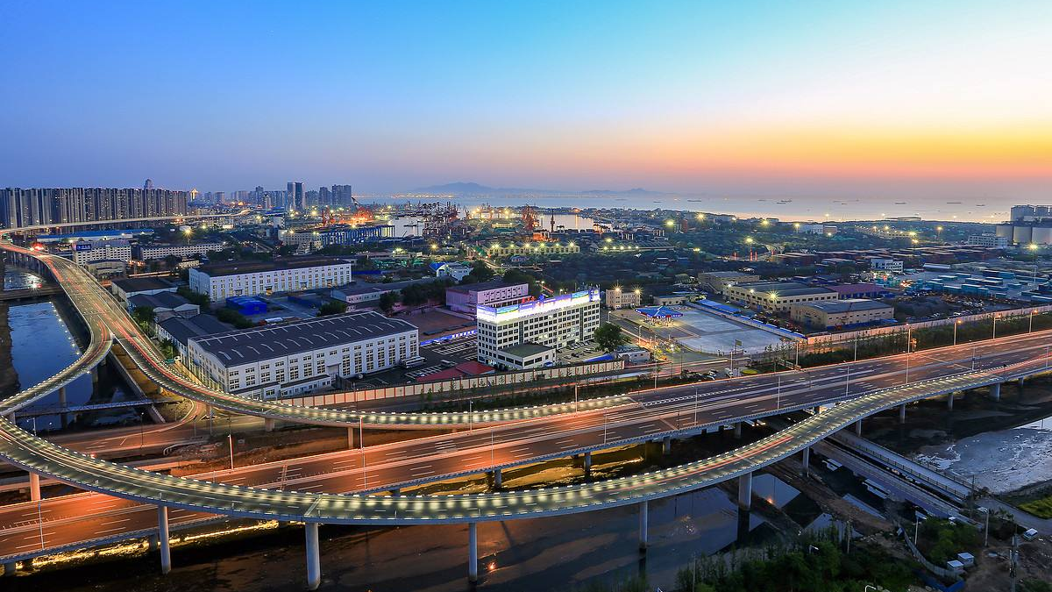
Thanks
Q&A

